Slide 1

Meeting 9-3-2022
Rosa Maessen

Slide 2
Progress this week
Literature
Project Proposal
09-10-2020

Slide 3
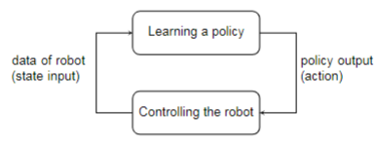
Literature
Adjusted comments
Intuitive examples
State input/action
09-10-2020

Slide 4
Project Proposal
Research Question
Research question:
Can skill mutation result in better performance when doing robot-to-robot learning?
Can skill mutation result from robot-to-robot learning?
Sub-questions:
How does the skill of a robot mutate during robot-to-robot learning?
Is skill mutation of robots’ skills reproducible?
What enables the mutation of the robots’ skills?
09-10-2020

Slide 5
Project Proposal
Objective
Shows if executing a robot-to-robot skill learning process executed multiple times under the same conditions, result in the same result.
Shows if a skill mutates when doing robot-to-robot skill learning.
Shows if changing a specific variable results in a different behavior.
09-10-2020

Slide 6
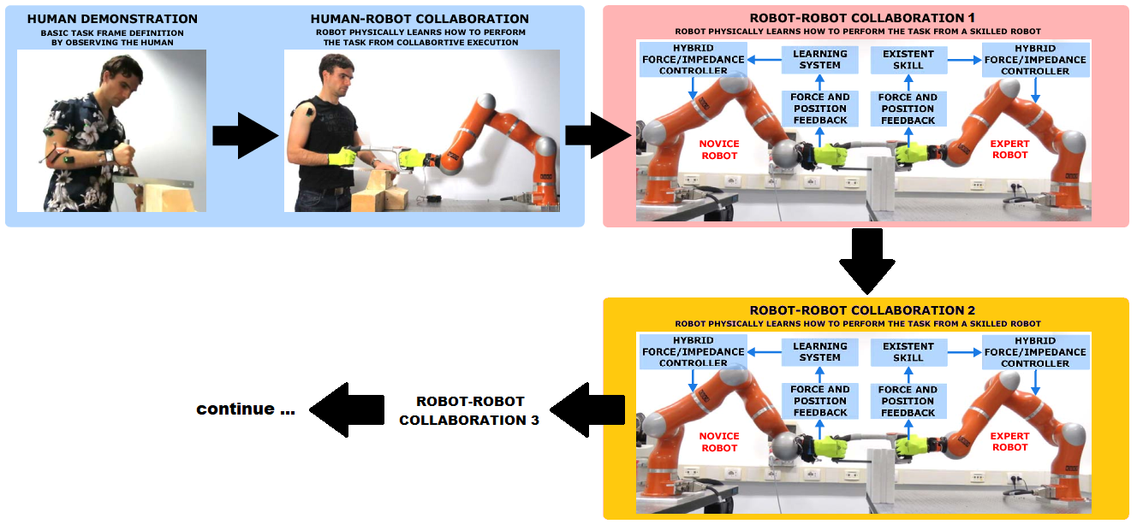
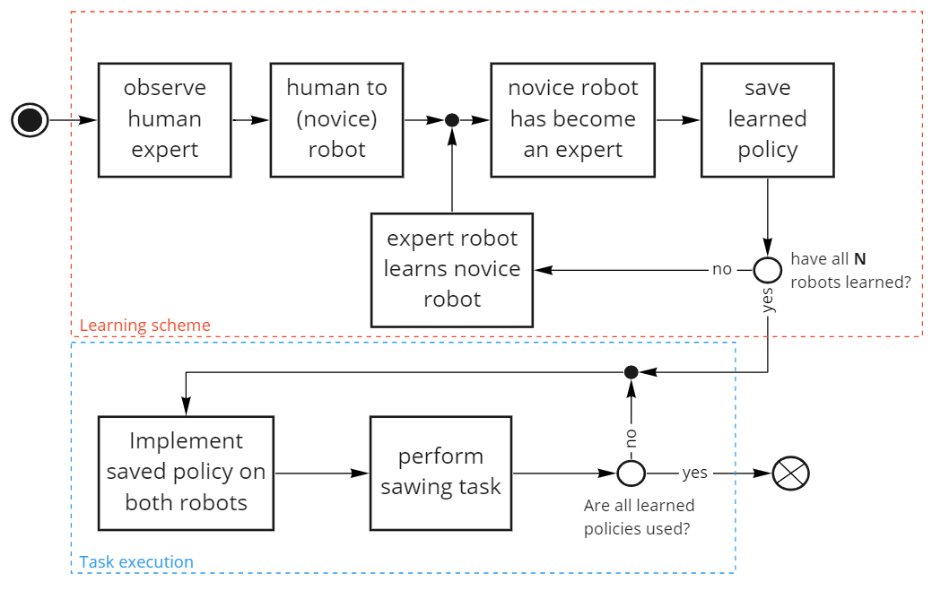
Experiment 1
09-10-2020

Slide 7
Experiment 2
Repeat experiment 1 multiple times.
09-10-2020

Slide 8
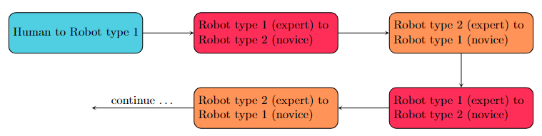
Experiment 3
Multiple conditions
Type of robots
Environments
Difficulty task
Initial demonstrations (e.g., another person)
Learning times (shorter/longer)
09-10-2020

Slide 9
Method
What do I need?
Starting code

Slide 10
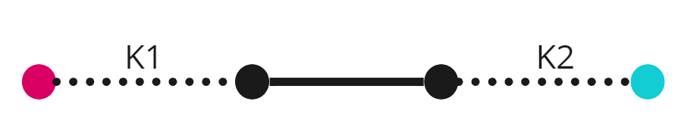
Python

Slide 11
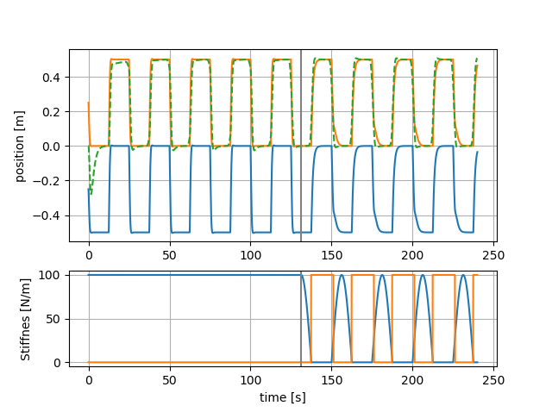
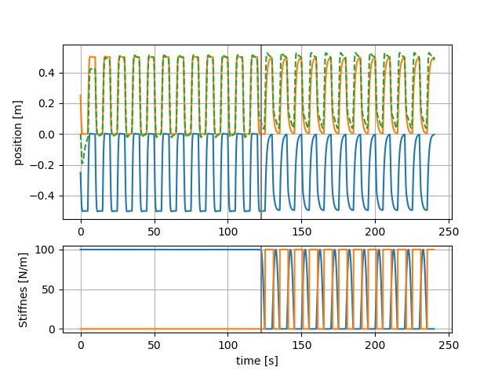
Python

